Slide 1
HATE SPEECH DETECTION using nlp & decision tree
Team Members
Aashna J. Chandrashekhar (RA2011027010009)
Sonal Shabir (RA2011027010010)
Shreya Dutta (RA2011027010033)

Slide 2
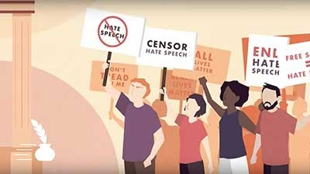
OBJECTIVE
What is hate speech?
Any speech that disparages a group of people because of their race, religion, nationality, national origin, sexual orientation, or gender identity is considered hate speech.
Therefore, to avoid bigotry and hatred we strive to create a model that can recognise or detect such conversations online and hence take a step towards reducing the adverse effect hate speeches have on mental health.

Slide 3
INSPIRATION OF THE PROJECT
In social media platforms, hate speech can be a reason of “cyber conflict” which can affect social life in both, the individual-level and the country-level.
Hateful and antagonistic content propagated via social networks has the potential to cause harm and suffering on an individual basis and thus leads to social tension and disorder beyond cyber space.
However, social networks cannot control all the content that users post. For this reason, there is a demand for automatic detection of hate speech.
Thus we got inspired to make a model for hate speech detection which is the task of detecting if communication such as text, audio, and so on contains hatred and or encourages violence towards a person or a group of people.

Slide 4
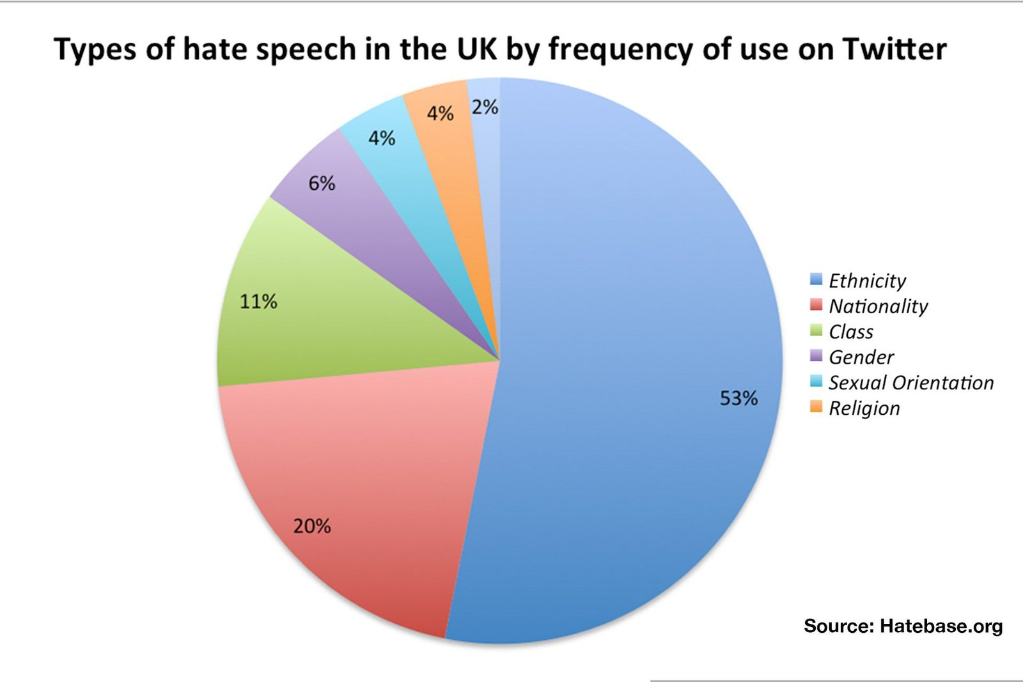
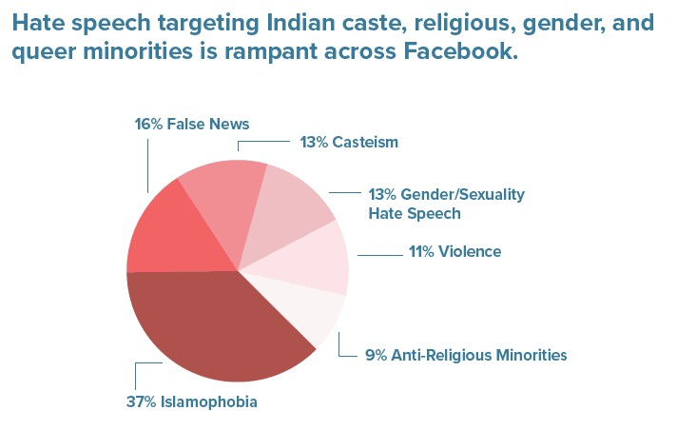
HATE SPEECH STATISTICS AROUND THE WORLD

Slide 5
ALGORITHM
To support and stabilise our model, we have chosen the Decision Tree Algorithm that predicts the value of a target variable by learning simple decision rules inferred from the data features.
Decision Tree is a supervised learning technique that can be used for both classification and regression problems, but mostly, it is preferred for solving classification problems.
How the algorithm works:
Decision nodes are used to make any decision and have multiple branches, where as Leaf nodes are the output of those decisions.
The decisions or the tests are performed on the basis of features of the given dataset and it simply asks a question and based on the answer (YES/NO), it further splits the tree into subtrees.
It is a graphical representation for getting all the possible solutions to a problem/decision based on given conditions.

Slide 6
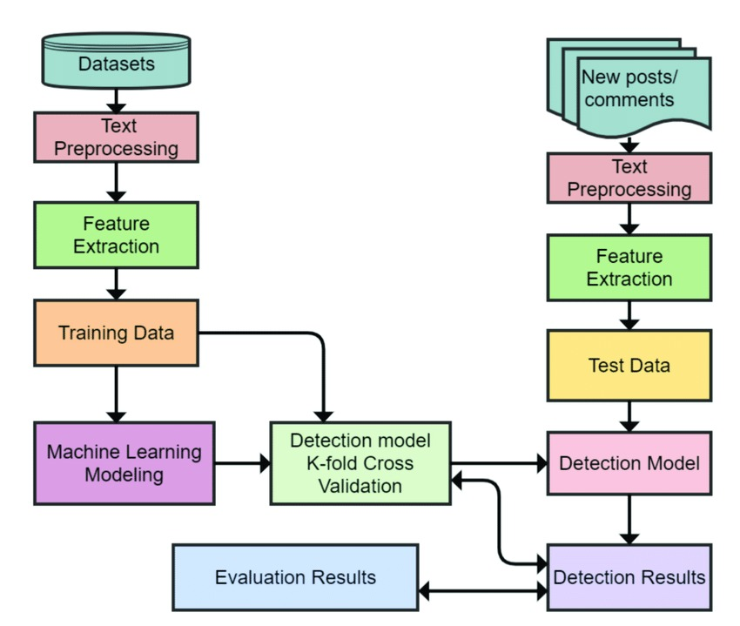
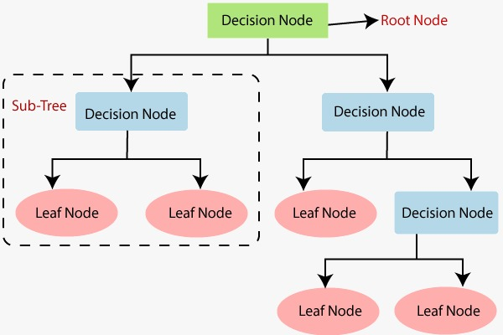
DECISION TREE ALGORITHM
DECISION TREE ARCHITECTURE FOR HATE SPEECH

Slide 7
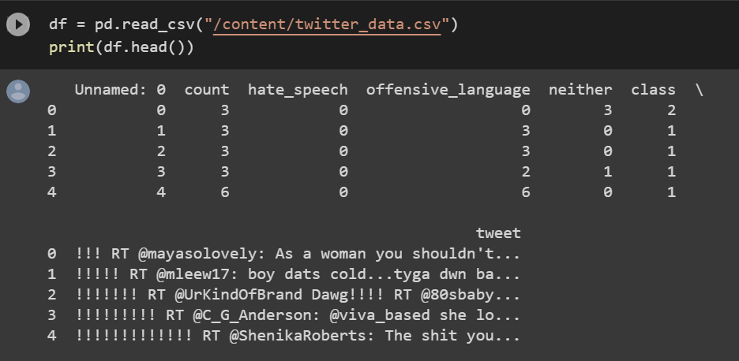
WORKING OF MODEL
Dataset used: twitter_data.csv

Slide 8
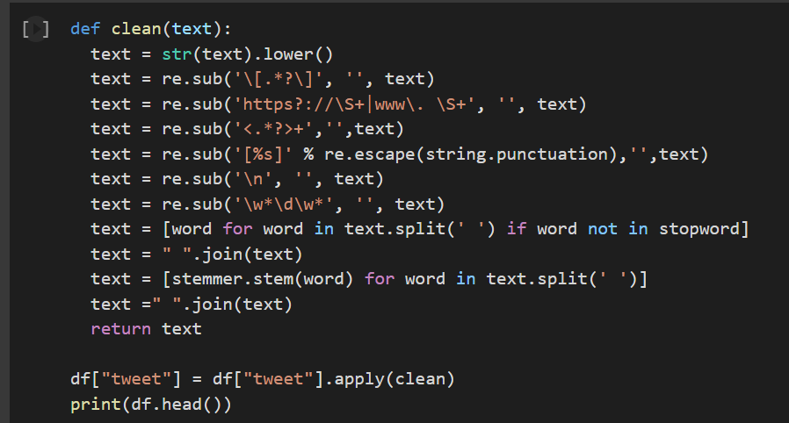
Input String: “I hate you”
i hate you
‘i’, ‘hate’, ‘you’
Here, ‘i’ and ‘you’ are stop words so they will be removed.
Remaining word/string: ‘hate’

Slide 9
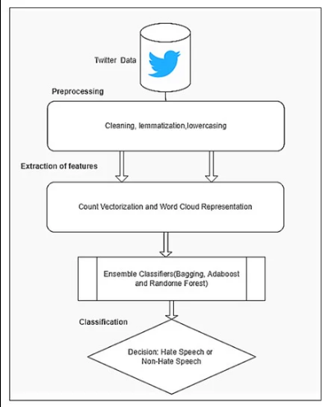
i hate you
Stop word
(removed)
Stop word (removed)
Decision Tree Classifier
No offensive language
NO
YES
Hate speech
Terminate
NO
YES
Not a Hate
Speech
‘hate’ is a Hate word, so sentence is a hate speech.

Slide 10
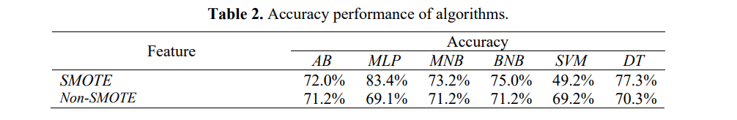
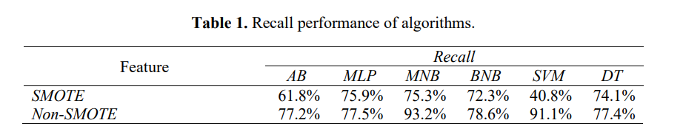
COMPARISONS OF DIFFERENT ALGORITHMS AND THEIR ACCURACY

Slide 11
COMPONENTS OF OUR MODEL
An agent can be anything that perceive its environment through sensors and act upon that environment through actuators. An Agent runs in the cycle of perceiving, thinking, and acting.
For our project,
Agent: The model trained on decision tree algorithm for detecting hate speech.
Actuator: It is the algorithm which interacts with the environment to give us the output for a given text and tells us whether it’s a hate speech or not.
Sensor: The training dataset that we have acquired from social media and have hence used to fit our model will be the sensor in our case.
Environment: Social media and its users.

Slide 12
EXPECTED OUTCOME
Therefore, we need to build a robust model working on decision tree algorithm for precise categorisation of hate speech.
As hate speech continues to be a societal problem, the need for automatic hate speech detection systems becomes more apparent.
Hence, we aim to create an effective algorithm that can identify and flag hate speech in various forms of online communication are apparent.

Slide 13
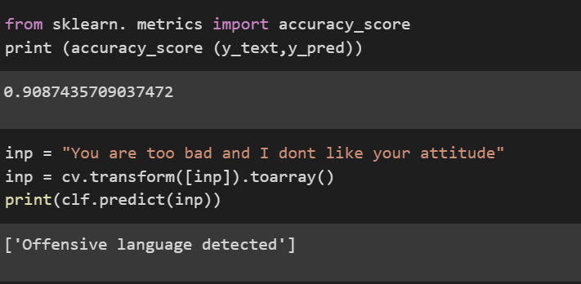
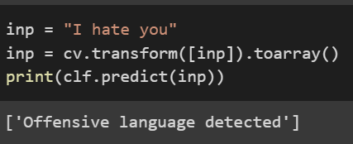
ACTUAL OUTCOME

Slide 14
CONCLUSION
Hate speech detection is a difficult task to accomplish because it involves processing text and understanding the context.
The hate speech data sets are usually not clean, so they need to be pre-processed before classification algorithms can detect hate speech in them.
Different machine learning models have different strengths that make some better than others for certain tasks such as detecting hate speech. Some models are more accurate while others are more efficient.
It is important to use different models and compare their performance in order to find the best one for hate speech detection. Pre-training methods have become popular in recent years and it is important to test whether they work well with hate speech detection algorithms.
It is also important to see how hate speech detection models can be used to address domain changes.

Slide 15
THANK YOU

